Slide 1
WHY STATISTICS IN BUSINESS ANALYTICS?
Business Decisions are Driven by Data
Every business generates enormous amounts of data every day. Statistics helps convert this raw data into meaningful information that supports better business decisions.
Examples
Which product sells the most?
Which customers are likely to leave?
Which marketing campaign is more successful?
What is the average monthly revenue?
How can future sales be predicted?
Statistics helps organisations
Understand business performance
Identify trends and patterns
Reduce uncertainty
Make evidence-based decisions

Slide 2
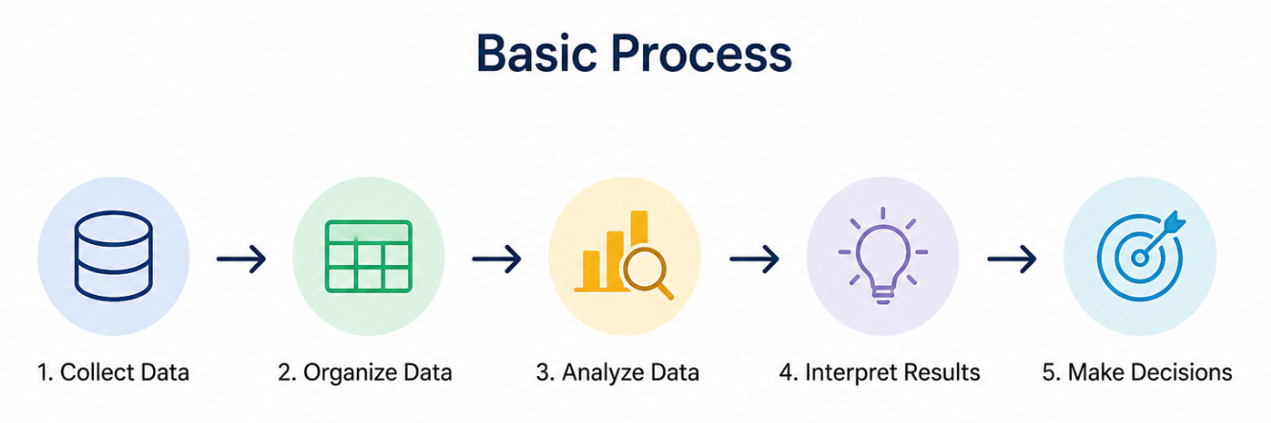
WHAT IS STATISTICS?
Statistics is the branch of mathematics that deals with the collection, organization, analysis, interpretation, and presentation of data to support informed decision-making.
Statistics converts raw data into useful information.
01

Slide 3
WHY DO WE NEED STATISTICS?
Business
Sales forecasting
Customer analysis
Market research
Healthcare
Disease prediction
Drug testing
Finance
Risk analysis
Investment planning
Education
Student performance analysis
Government
Census
Economic planning
02

Slide 4
STATISTICS IN BUSINESS ANALYTICS
Real-Life Example
An online shopping company analyzes:
Daily visitors
Number of purchases
Customer ratings
Using statistics, the company identifies:
Best-selling products
Peak shopping hours
Customer preferences
Applications
Customer segmentation
Sales trend analysis
Fraud detection
Inventory optimization
Demand forecasting
Employee performance analysis
03

Slide 5
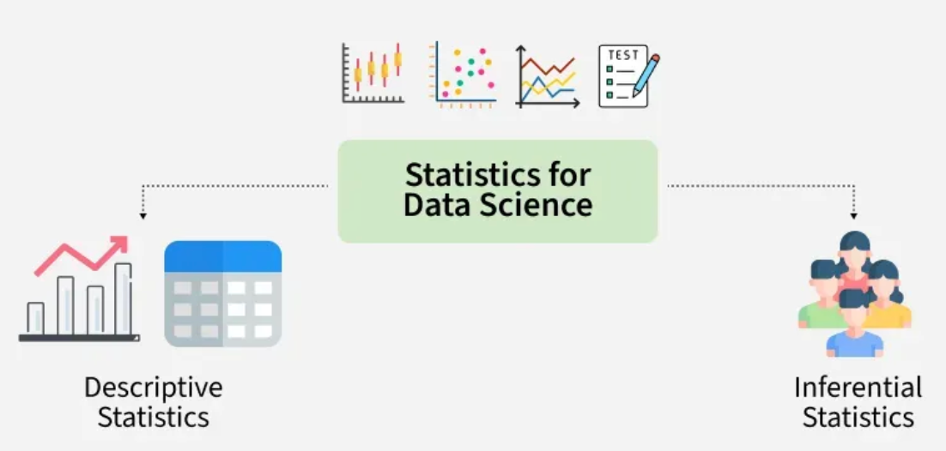
TYPES OF STATISTICS
04

Slide 6
DESCRIPTIVE STATISTICS
Descriptive statistics summarise and present data in a meaningful way without making predictions.
Common Techniques
Mean
Median
Mode
Range
Variance
Standard Deviation
Charts
Tables
05

Slide 7
APPLICATIONS OF DESCRIPTIVE STATISTICS
Used in
Monthly sales reports
Employee salary reports
Customer satisfaction analysis
Product performance
Website traffic analysis
06

Slide 8
INFERENTIAL STATISTICS
Inferential statistics uses sample data to draw conclusions or make predictions about an entire population.
Common Techniques
Hypothesis Testing
Confidence Intervals
Regression Analysis
Correlation Analysis
Prediction Models
07

Slide 9
DESCRIPTIVE VS INFERENTIAL STATISTICS
Descriptive Statistics | Inferential Statistics
Describes existing data | Predicts future outcomes
Works on complete available data | Uses sample data
No prediction | Makes predictions
Uses graphs and summary measures | Uses probability and hypothesis testing
Example: Average salary | Example: Predict future salary trend
08

Slide 10


THANK YOU

